Slide 2
Outcomes from today’s workshop
You will understand:
What we mean by workplace literacy
How training session are documented
The content of each toolkit
The key principles of adult learning
The literacy learning cycle
Preparation for a workshop
How to seek feedback and reflect on a workshop

Slide 3
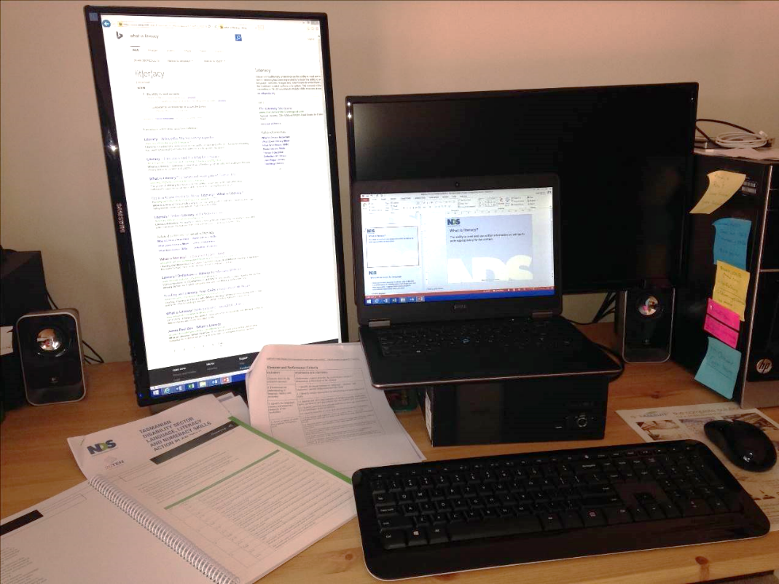
What do we mean by workplace literacy?
Literacy is the ability to read and use written information as well as to write appropriately for the context.
Page 3

Slide 4
What do we mean by language?
Language involves listening as well as using verbal and non-verbal forms of communication, such as gestures and body movements. Together these enable people to communicate meaningfully with each other.
Language skills enable:
Familiarity with workplace terminology
Appropriate word choice
Use of various dialects
Use of other languages
Page 3

Slide 5
What we mean by numeracy?
Numeracy is about:
Using numbers to make sense of the world
Applying maths for a social purpose
What tasks use numeracy skills in the DSW role?
Page 3

Slide 6
Summarising workplace literacy
Broadly, when we talk about workplace literacy, we think about all of these areas.
In the Toolkits we focus only on language and literacy.

Slide 7
Signs that someone has literacy concerns
Very weak hand writing skills
Make excuses
I forgot my glasses
My hand is sore
I forgot
Avoid the task
“I’ll do this, while you write up the notes”
absent on days when skills are required
laugh and joke around a lot so it appears they’ve run out of time
Get around the task
Copy from others
Replicate a previous document
Write the bare minimum
Refusal to complete the tasks
Page 3

Slide 8
Outcomes
You will understand:
What we mean by workplace literacy
How training session are documented
The content of each toolkit
The key principles of adult learning
The literacy learning cycle
Preparation for a workshop
How to seek feedback and reflect on a workshop

Slide 9
The toolkits
There are 4 Toolkits
Each has 2 parts:
Trainer guide
Learner workbook

Slide 10
What’s in the trainer guide?
Session objectives
Resources required
Duration
Learner group
Context
Session plan
Trainer prompts

Slide 11
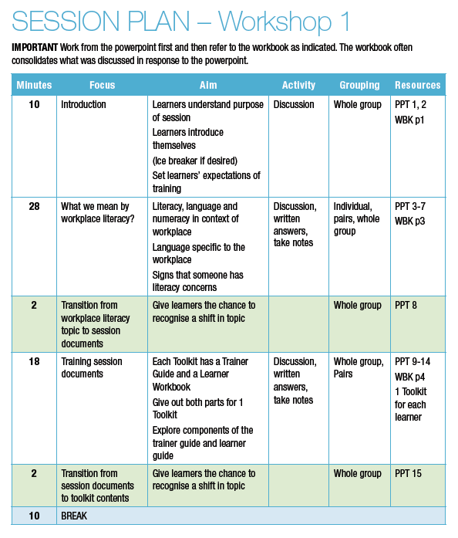
The session plan
Time
Focus
Aim
Activity
Grouping
Resources

Slide 12
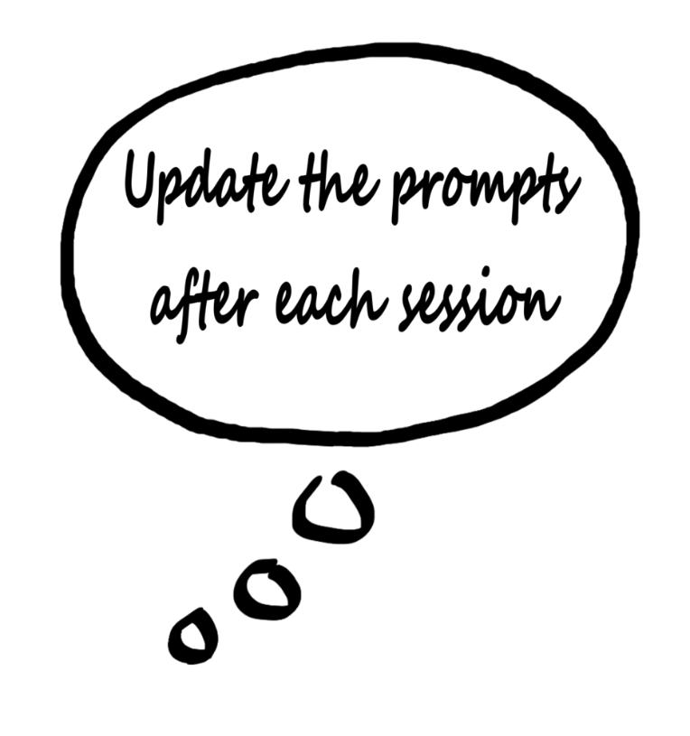
The trainer prompts
Provide context for information or activities
Help if the group can’t think of a response
Outline some of the expected responses
Check the prompts after the discussion to see if there are any relevant and outstanding

Slide 13
What’s in the learner guide?
Learning Material
Directions
Examples
Excerpts
Activities
Group discussions
Research
Reflection
Written Questions
Put things in your own words
Take information back to share with your team

Slide 14
Timing and activities
Keeping the training session on time
Let your learners know how long they have with the questions and activities
Keeping track of how quickly or slowly the workshop is moving
Use a blend of activity types to suit the audience and timeframe
Page 4

Slide 15
Outcomes
You will understand:
What we mean by workplace literacy
How training session are documented
The content of each toolkit
The key principles of adult learning
The literacy learning cycle
Preparation for a workshop
How to seek feedback and reflect on a workshop

Slide 16
Explore the Toolkits
Creating exemplar progress notes with guidelines
Writing with bullet points
Getting started with Plain English
Writing objective progress notes
You can find the Toolkits at this URL: www.nds.org.au/the-workplace-literacy-project

Slide 17
Get to know each Toolkit
Jigsaw activity
Page 5-7

Slide 18
Jigsaw activities
A jigsaw activity is a good way to get a group to learn about detailed information.
Chunk up the information
Divide the group into subgroups
Give each subgroup a chunk of information to research
Each subgroup reports back to the main group
Main group can ask questions
Trainer can add information as needed during discussion
What are the advantages of this approach?
What might you need to consider before planning this kind of activity?

Slide 19
Outcomes
You will understand:
What we mean by workplace literacy
How training session are documented
The content of each toolkit
The key principles of adult learning
The literacy learning cycle
Preparation for a workshop
How to seek feedback and reflect on a workshop

Slide 20
The key principles of adult learning - Androgogy
The need to know
The learner’s self-concept
The role of the learner’s experience
Readiness to learn
Orientation to learning
Motivation
Page 8

Slide 21
The key principles of adult learning - Andragogy
Page 12

Slide 22
How to train employees: Effective adult training programs

Slide 23
Learning preferences
Sound
Learning by listening
Sight
Learning by reading and/or watching
Touch
Learning by doing
Page 13-18

Slide 24
Bringing it all together
Discussion activities
Page 19

Slide 25
Outcomes
You will understand:
What we mean by workplace literacy
How training session are documented
The content of each toolkit
The key principles of adult learning
The literacy learning cycle
Preparation for a workshop
How to seek feedback and reflect on a workshop

Slide 26
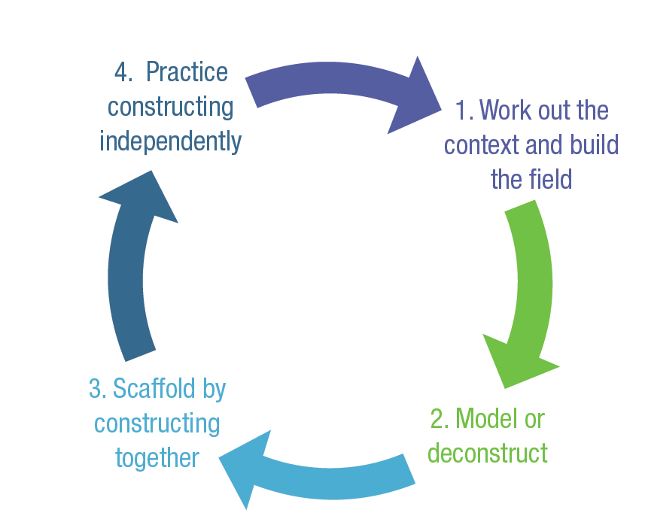
The literacy learning cycle
Page 21

Slide 27
Outcomes
You will understand:
What we mean by workplace literacy
How training session are documented
The content of each toolkit
The key principles of adult learning
The literacy learning cycle
Preparation for a workshop
How to seek feedback and reflect on a workshop

Slide 28
Preparing for a workshop
Discussion activities
Page 22

Slide 29
Preparing for a workshop
Resources
Trainer guide
Learner workbooks
Whiteboard
Markers & eraser
Pens & highlighters
Logistics
Date and time
Arrange venue
Promote training
Confirm attendees
Evaluation
Feedback form
Follow up

Slide 30
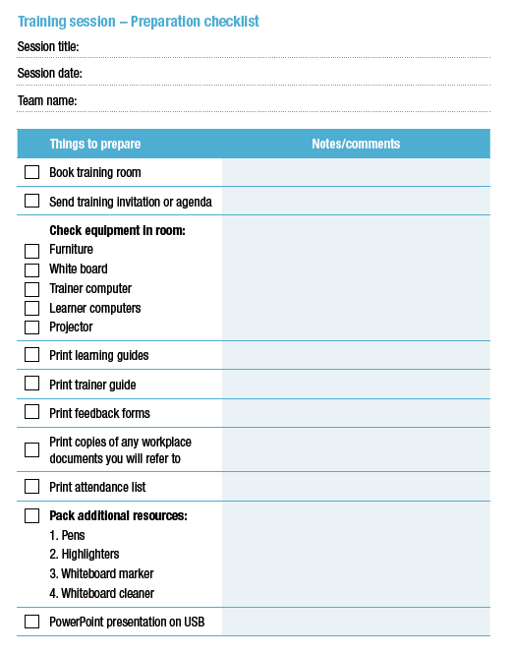
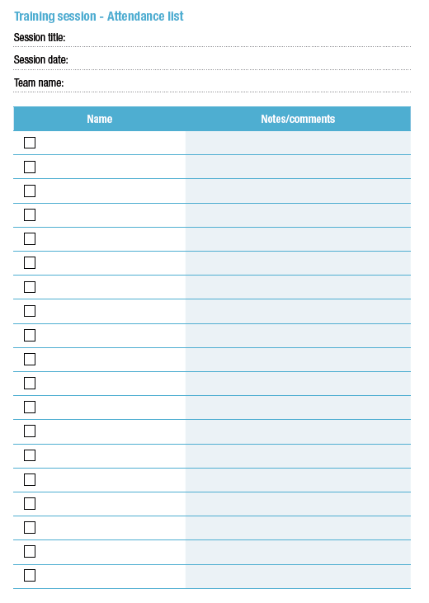
Preparing for a workshop
Page 23-24

Slide 31
During the workshop
Be yourself
Observe the learners
Keep track of time
Page 25

Slide 32
Outcomes
You will understand:
What we mean by workplace literacy
How training session are documented
The content of each toolkit
The key principles of adult learning
The literacy learning cycle
Preparation for a workshop
How to seek feedback and reflect on a workshop

Slide 33
Evaluation – seeking feedback & reflecting
STEP 1. Define the issue
STEP 2. Seek feedback from learners
STEP 3. Reflect on the session
STEP 4. Ask workplace supervisors for feedback
STEP 5. Analyse the information*
*we do this in workshop 2
Page 26-31

Slide 34
Outcomes
You will understand:
What we mean by workplace literacy
How training session are documented
The content of each toolkit
The key principles of adult learning
The literacy learning cycle
Preparation for a workshop
How to seek feedback and reflect on a workshop

Slide 35
Before the next workshop
Call the trainer if you need any help, clarification, encouragement, …
Run a Toolkit session in your workplace
Next session bring completed:
Issue (p 27)
Learner feedback summary (p 29)
Self-reflection (p 30)
Workplace supervisor feedback (p 31)
Think about a topic you want to prepare a workshop on

Slide 36
Workshop 2
Date
Time
Venue

Slide 37
Contact details
Michele Foley
Michele.foley@nds.org.au
03 6212 7303
Cath Ralston
Cath.Ralston@nds.org.au
03 6212 7305

