Slide 2
Recap from workshop 1
We covered:
What we mean by workplace literacy
How training session are documented
The content of each toolkit
The key principles of adult learning
The literacy learning cycle
Preparation for a workshop
How to seek feedback and reflect on a workshop

Slide 3
Outcomes from today’s workshop
You will learn how to:
Evaluate your training session(s)
Support longer-term outcomes
Use techniques for engaging learners
Identify and work with tricky group dynamics
Report on your training
Design a short training session

Slide 4
Outcomes from today’s workshop
You will learn how to:
Evaluate your training session(s)
Support longer-term outcomes
Use techniques for engaging learners
Identify and work with tricky group dynamics
Report on your training
Design a short training session

Slide 5
Evaluate your workshop delivery
What issue did you plan to address?
What were your objectives?
Page 3
Page 3

Slide 6
1. Reflection
What went well?
What didn’t go well?
What could be different next time?
Page 3

Slide 7
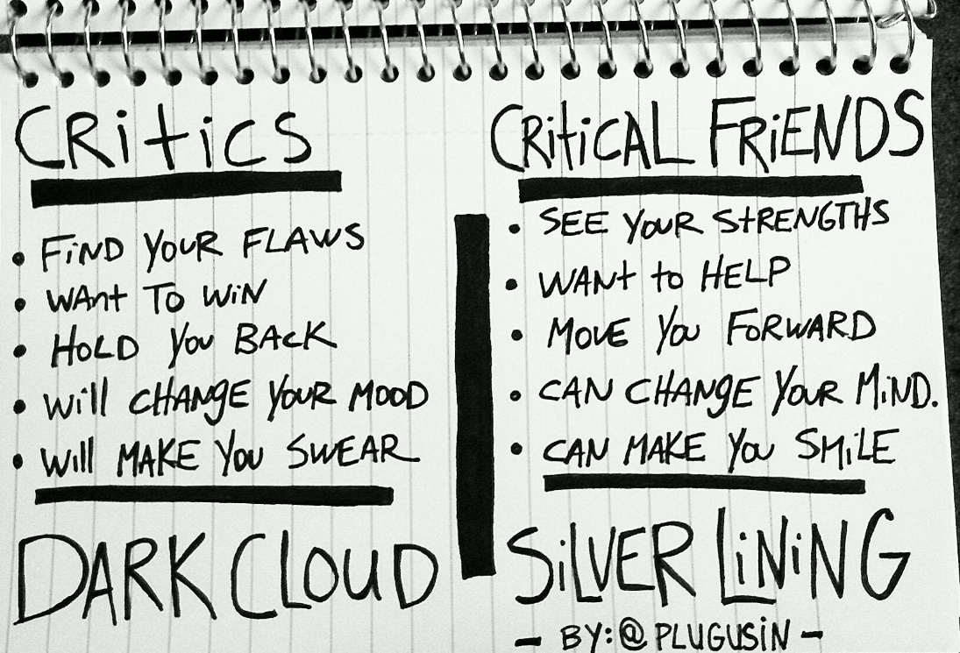
Analysis with a critical friend
Page 4
Image taken from this URL https://sonyaterborg.com/2014/04/04/the-value-of-a-critical-friend/
Page 4

Slide 8
Analysis activity
Page 4
Page 4-5
Page 5

Slide 9
Outcomes from today’s workshop
You will learn how to:
Evaluate your training session(s)
Support longer-term outcomes
Use techniques for engaging learners
Identify and work with tricky group dynamics
Report on your training
Design a short training session

Slide 10
Support longer-term outcomes
Follow-up with learners in their workplace
Coach supervisors
Page 7
Page 7-9

Slide 11
Outcomes from today’s workshop
You will learn how to:
Evaluate your training session(s)
Support longer-term outcomes
Use techniques for engaging learners
Identify and work with tricky group dynamics
Report on your training
Design a short training session

Slide 12
How can you tell if a learner is engaged?
Listening
Nodding
Reading
Writing
Contributing to discussions
Thinking expression on their face
Making eye contact with trainer
Page 10
Notes:
Ask the learners for a list and write on the white board before revealing these

Slide 13
How can you tell if a learner is not engaged?
Looking out the window
Reading ahead in their book
Playing with their phone
Sleep
Doodling a lot
Not participating in discussions
Avoiding interaction with the group of trainer
Distracted
Page 10
Notes:
Ask the learners for a list and write on the white board before revealing these

Slide 14
What are some barriers to engagement?
Learners don’t understand relevance of the training
The material is too difficult or too easy
The pace is too fast or too slow
There is too much talk by the trainer
The group is too big
The room is too warm or too dark
Learners worried about saying the wrong thing
A dominant person doesn’t let others have a say
A problem from outside the session is influencing the group
Learners are tired, worried about workload, etc.
Page 10-11
Notes:
Ask the learners for a list and write on the white board before revealing these

Slide 15
Remember the principles of adult learning?
The need to know
The learner’s self-concept
The role of the learner’s experience
Readiness to learn
Orientation to learning
Motivation
Page 12
Notes:
Prompt learners to re-read info from session 1

Slide 16
Techniques for engagement 1
The training materials
Clearly explain how the training applies to specific workplace duties
Think about the audience as you develop the materials
What do they already know?
What is their experience with the topic?
Do they have the literacy and numeracy skills, or do these need to be taught?
Use a clear structure with headings and explicit transitions
Work out the order in which you need to cover topics - sequencing
Use a variety of methods to accommodate learning styles
Allow learners to draw on existing knowledge, rather than tell them everything
Update your materials regularly on the basis of feedback
Page 12-13

Slide 17
Techniques for engagement 2
The training environment
Make sure the room is a good temperature, with good lighting
Make sure learners have food and drink as needed
In general, the group should not be more than about 10-12 people
Before the session
Make sure learners won’t be interrupted
Ask supervisor to arrange cover and encourage the learner to participate
Get a heads up from the supervisor about any dynamics or issues in the group that you should know about
Make sure learners know the location, start and finish times, and break times
Make sure you have a good knowledge of the topic and are really familiar with the training materials
Page 12-13

Slide 18
Techniques for engagement 3
During the session
Start on time
Suggest turning phones off, and give time during breaks to check
Use an icebreaker activity to have a laugh and give everyone the chance to introduce themselves
Let learners know that asking questions is fantastic!
Make sure timing is appropriate, adjust throughout session as appropriate
Speak clearly, pause as needed
Page 12-13

Slide 19
Techniques for engagement 4
Manage discussions
Encourage a collegial learning environment through use of discussion and critical friends
Give learners time to think after you’ve asked a question – don’t jump in
Don’t let discussion get side-tracked – stick to the aims and time allocation for each segment
Ensure everyone has a chance to have input – manage dominant characters (we’ll discuss this shortly)
Page 12-13

Slide 20
Techniques for engagement 5
Are there any techniques that you are unsure about?
Page 12-13
There are some extra self-directed activities on page 14

Slide 21
Outcomes from today’s workshop
You will learn how to:
Evaluate your training session(s)
Support longer-term outcomes
Use techniques for engaging learners
Identify and work with tricky group dynamics
Report on your training
Design a short training session

Slide 22
Identify and work with tricky group dynamics
Top #5
Personalities
Attitudes
Staying on topic
Controlling the room
Keeping the pace
Page 15
Page 16

Slide 23
Outcomes from today’s workshop
You will learn how to:
Evaluate your training session(s)
Support longer-term outcomes
Use techniques for engaging learners
Identify and work with tricky group dynamics
Report on your training
Design a short training session

Slide 24
Reporting
Stage 3 of evaluation
Audience
You are generally writing for your supervisor, the learners’ supervisor and management
Purpose
To give information about what happened, the outcomes, and what you think needs to change
Page 17-19

Slide 25
Outcomes from today’s workshop
You will learn how to:
Evaluate your training session(s)
Support longer-term outcomes
Use techniques for engaging learners
Identify and work with tricky group dynamics
Report on your training
Design a short training session

Slide 26
Design a short training session 1
Step 1 – Recognise your purpose
What workplace issue(s) are you trying to solve?
What workplace task(s) does the training aim to address?
Who will you train (your audience)? What do you know about them?
What is the title of your session?
Page 20

Slide 27
Design a short training session 2
Step 2 – Plan the structure and sequence
Structuring is working out the topics you will cover
Sequencing is working out the order you will cover it
Page 21

Slide 28
Design a short training session 3
Step 3 - Use the session plan
Use a template to enter your topics and subtopics in order
Describe your expected outcome(s) for each subtopic
Check with your critical friend and update to reflect their feedback
Page 22

Slide 29
Design a short training session 4
Step 4 – Plan the activities
Use a range of activities to support all learning preferences
Visual
Auditory
Kinaesthetic
Have a good range, but don’t make it crazy
Page 22

Slide 30
Design a short training session 5
Step 5 – Add times
Allow enough time
Page 23

Slide 31
Design a short training session 6
Step 6 – Review and edit activities
You might need to edit your plan if you find you’re trying to do too much
Don’t be tempted to cut short times if you need it allow learning to happen
Engage all learning preferences
Page 23

Slide 32
Design a short training session 7
Step 7 – Develop teaching and learning materials
Remember and incorporate the principles of adult learning
Appeal to all learning preferences
Use Plain English
Page 24

Slide 33
Outcomes from today’s workshop
You will learn how to:
Evaluate your training session(s)
Support longer-term outcomes
Use techniques for engaging learners
Identify and work with tricky group dynamics
Report on your training
Design a short training session

Slide 34
Contact details
Michele Foley
Michele.foley@nds.org.au
03 6212 7303
Cath Ralston
Cath.Ralston@nds.org.au
03 6212 7305

